Slide 1
The Lapidarist* Problem
Braulio piña amaros

Slide 2
The lapidarist* problem
The Prime Minister needs help validating the claim from Mr. Krenk about the diamonds that seem to have been stolen.
Create a model to value the missing diamonds.

Slide 3





Diamonds data Preview
# | COLUMN | NON-NULL COUNT | DTYPE
0 | Carat | 53930 non-null | Float64
1 | Cut | 53930 non-null | Object
2 | Color | 53930 non-null | Object
3 | Clarity | 53930 non-null | Object
4 | Depth | 53930 non-null | Float64
5 | Table | 53930 non-null | Float64
6 | Price | 53930 non-null | Int64
7 | X | 53930 non-null | Float64
8 | Y | 53930 non-null | Float64
9 | z | 53930 non-null | float64

Slide 4
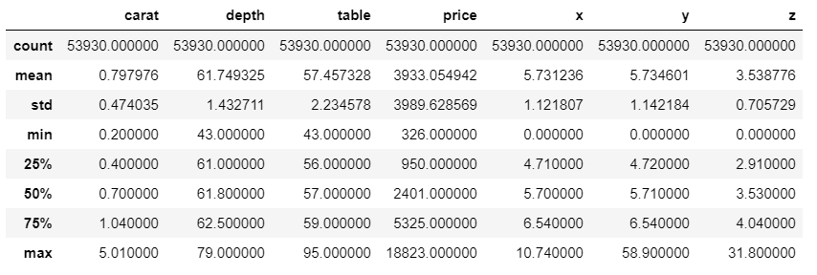
Measures of Central Tendency
X,Y and Z are Cartesian measures the cannot include values equal to zero.
We take them out and now we will work with 53910 observations

Slide 5
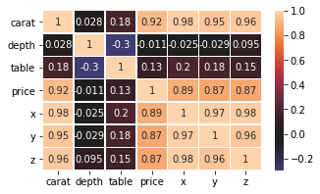
Correlation
We can see that x,y and z have a big correlation between each other
Carat is the most correlated variable to the Price

Slide 6
We have a problem of multicollinearity between x,y and z. So from x*y*x, we will create a new variable, the “volume” of the diamonds.

Slide 7
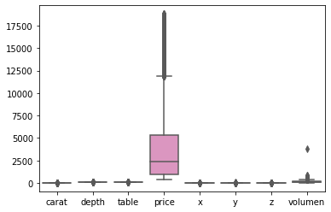
Qualitative distribution of the numeric variables and the scale in which they are.

Slide 8
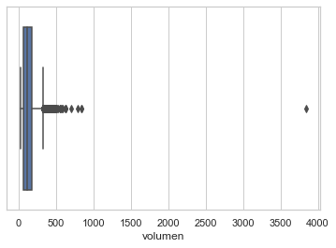
Distribution of the variable “volume”
We remove:
17 observations that have volume greater than 500
1 observation that have volume greater than 1000
We have now 53893 observations

Slide 9
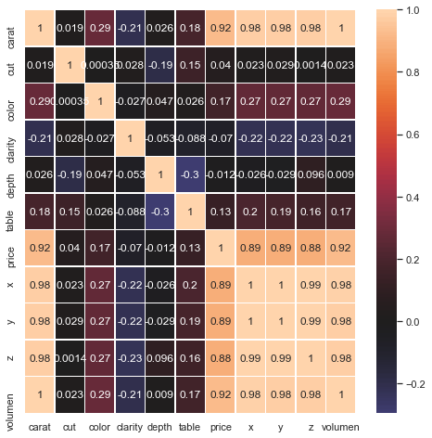
Correlation of the all variables
Most correlated variables with the Price are Carat and Volume
The bigger the diamond, higher the price

Slide 10
Preparing data for the model
Divide variables in explanatory and objective.
Divide variables: 80% training and 20% test
Standardize variables
Metrics for evaluation:
R-Squared: explanation percentage that the explanatory variables give to the output variable
Mean Absolute Error (MAE): the mean absolute distance between X and Y
Mean Square Deviation (RMSE): the squared root of the squared average errors. The effect of each error is proportional to the size of the quadratic error.

Slide 11
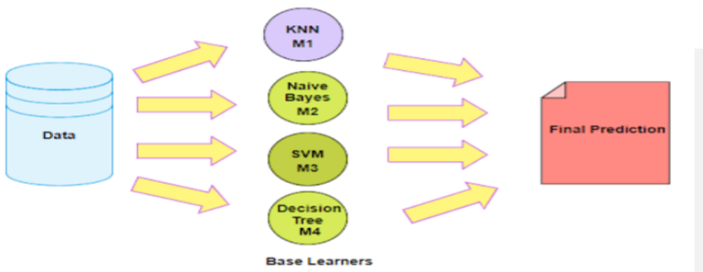
Models
Algorithms of the emsembling type.
Two boosting and one bagging
Ensemble method is a technique that combines the predictions from multiple machine learning algorithms together to make more accurate predictions than any individual model
GradientBoosting
RandomForest
XGBOOST
Advantages:
Great predictive power
Efficient because of the RAAM use and the data size
Custom evaluation metric
Previous experience

Slide 12
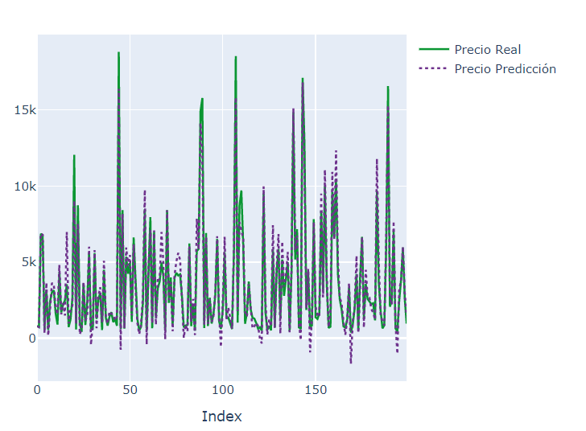
Forecasts versus Real GradientBoosting
Price

Slide 13
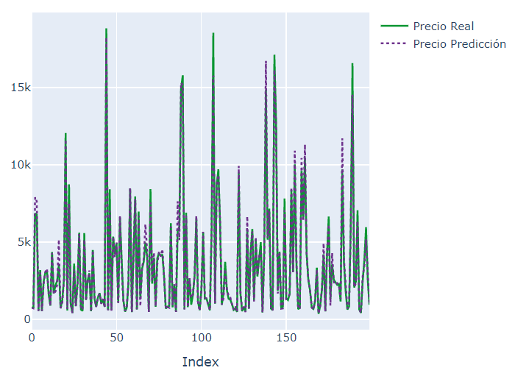
Forecast versus Real RandomForest
Price

Slide 14
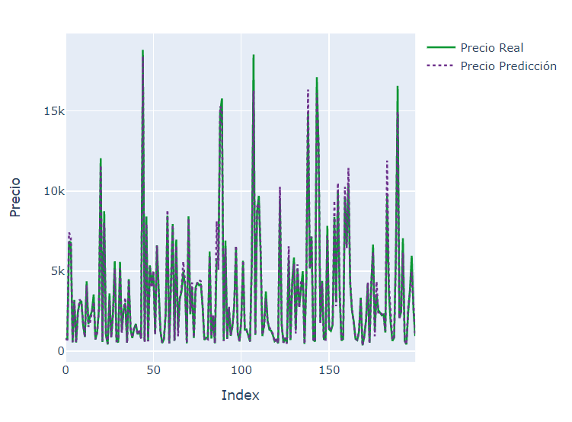
Forecast versus Real XGBOOST
Price

Slide 15
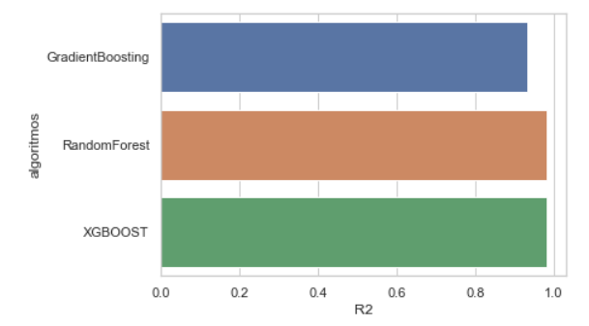
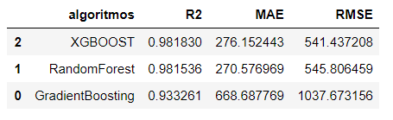
Metrics Comparison

Slide 16
XGBOOST and RandomForest contain more similar values between the forecast and the real data
We choose XGBOOST model because its RMSE was the least and its R2 was the higher.
XGBOOST is also computationally more efficient than RandomForest
XGBOOST does not contains bias towards the categories with the greatest levels

Slide 17
Conclusion
The model was based in creating quality features
The problem was attack from the presence of outliers
A new variable was created to solve the multicollinearity between x,y and z. That new variable “Volume” was useful for a better capture of the variability of the data set.
Carat and volume were the characteristics which influence the most the Price of the diamonds.
The price of the diamond was also determined in great measure from its size.
Analysis should continue with a tuning of the hyperparameters so we can get a better development of the algorithms

